Slide 1
The BIO-Boost project has received funding from the European Union’s Horizon Europe coordination and support action under grant agreement No 101096150.

Slide 2
TITLE Subtitle
Organization
^{Presenter, Position}
^{Event type: Event name}
^{xx.xx.202x}
The BIO-Boost project has received funding from the European Union’s Horizon Europe coordination and support action under grant agreement No 101096150.

Slide 3
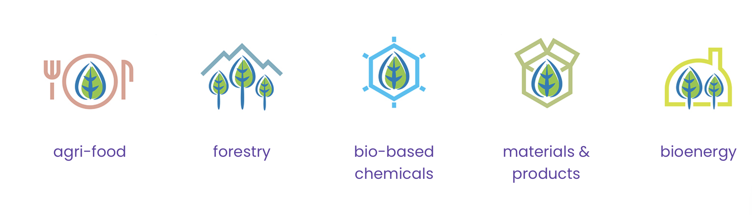
Project objective and focus
Boosting innovation agencies
for bioeconomy value chains

Slide 4
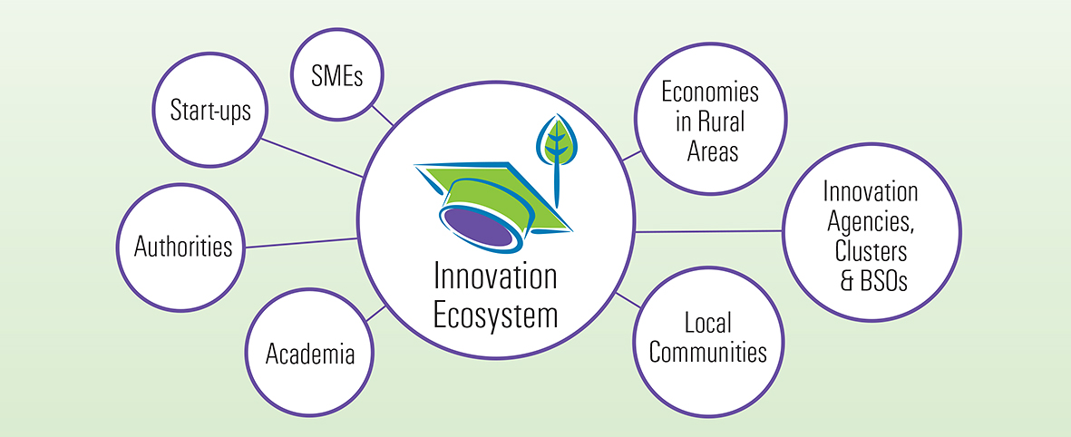
BIO-Boost innovation ecosystems

Slide 5
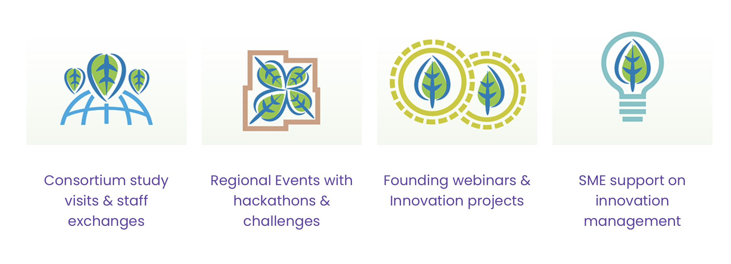
Project activities
24
3
8
7
Events for at least
160 organizations
(one in each BIO-Boost country)
online events
for at least 210 SMEs
SMEs supported by
international innovation
consultancy provided
by BIO-Boost partners
to all BIO-Boost
partner countries

Slide 6
BIO-Boost consortium
27 June 2023
Granada, Spain

Slide 7
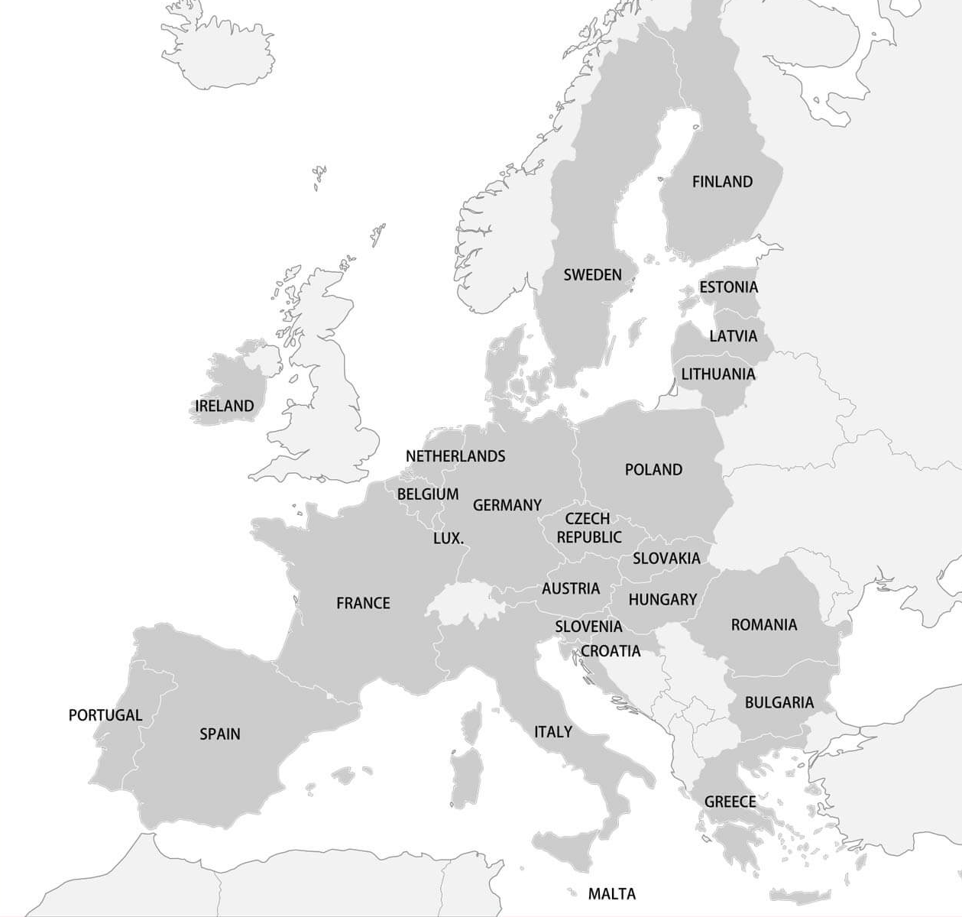
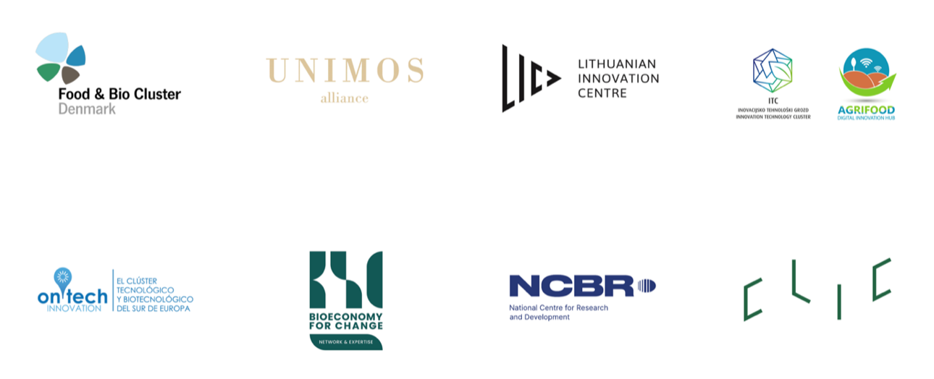
Project partners
8 cluster, business innovation and public financing organizations from 7 European countries:
Denmark
France
Finland
Spain
Poland
Slovenia
Lithuania

Slide 8
Project coordinator
Denmark
Conny Hanghøj
The BIO-Boost project has received funding from the European Union’s
Horizon Europe coordination and support action under grant agreement No 101096150.

Slide 9
Project partner
Poland
Katarzyna Kowalska
The BIO-Boost project has received funding from the European Union’s
Horizon Europe coordination and support action under grant agreement No 101096150.

Slide 10
Project partner
Poland
Maciej Zdanowicz
The BIO-Boost project has received funding from the European Union’s
Horizon Europe coordination and support action under grant agreement No 101096150.

Slide 11
Project partner
Lithuania
Tautvydas Pipiras
The BIO-Boost project has received funding from the European Union’s
Horizon Europe coordination and support action under grant agreement No 101096150.

Slide 12
Project partner
Finland
Tiina Witikkala
The BIO-Boost project has received funding from the European Union’s
Horizon Europe coordination and support action under grant agreement No 101096150.

Slide 13
Project partner
Slovenia
Darja Kukovic
Alexandra Kocet
The BIO-Boost project has received funding from the European Union’s
Horizon Europe coordination and support action under grant agreement No 101096150.

Slide 14
Project partner
France
Chloe Joly
Mouhamed Niakate
The BIO-Boost project has received funding from the European Union’s
Horizon Europe coordination and support action under grant agreement No 101096150.

Slide 15
Project partner
Spain
Fátima Carmona Sánchez
Emilio Rull Quesada
The BIO-Boost project has received funding from the European Union’s
Horizon Europe coordination and support action under grant agreement No 101096150.

Slide 16
Overview
Xxxx
…
Notes:
Please briefly provide the objectives of this WP (not necessary those descripted in the DoA).
Strategy: Provide a describe of the strategy that will be followed in order to secure and achieve the KPIs as well as to expand the awareness even after the end of the project.
Tools and actions: Provide the tools and the actions that you intend to include into the project and how the rest of the partners should be included/ participated in the process.
Timeline: Provide a timeline of the main actions that should be followed in the next six months for this WP and the main milestones that should be achieved.
Challenges and mitigation measures: What challenges do you foresee? Please provide the respective mitigation measures.
Next steps: What your imminent next steps will be in order to initiate the WP?

Slide 17
Thank you for your attention
Photo
Email address

